Slide 1
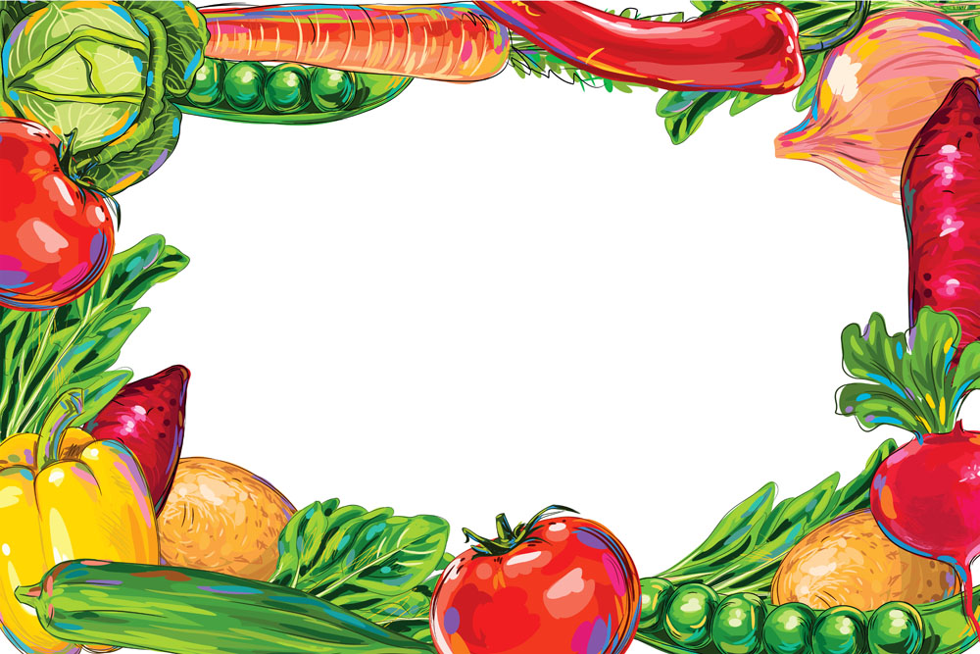
A Weekly Food Menu Planner
Just for YOU
Food Butler
Team: Gary Song, Lisa Li, Tony Yan, Xinyi Ge

Slide 2
Daily Struggles
From Last Time…
Don’t know what to cook for today’s meals
Don’t know what to buy in the supermarket
Don’t know how to deal with ingredients left in the fridge
Don’t know how to address nutritional needs for fitness or dietary restrictions
Notes:
Xinyi

Slide 3
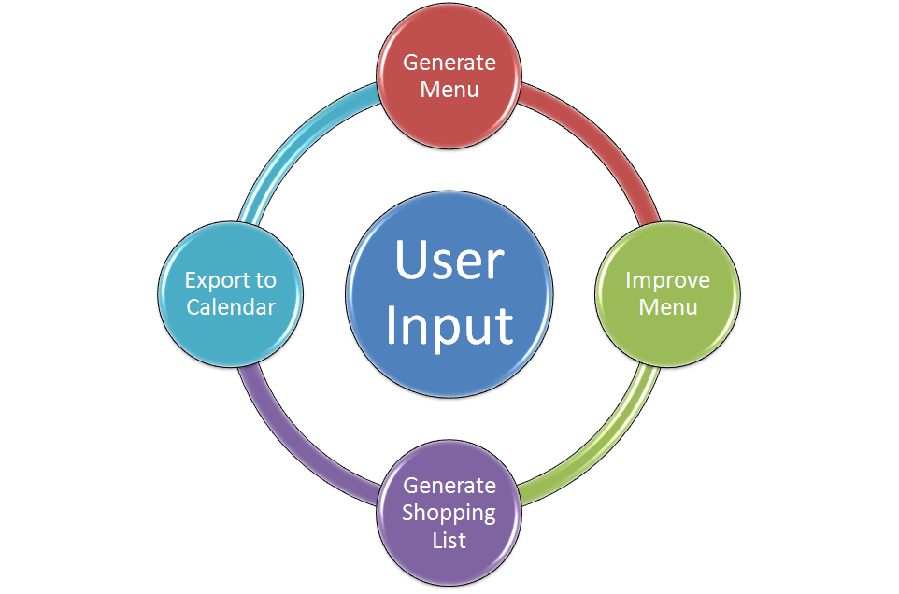
Notes:
Xinyi

Slide 4
Demo
Notes:
Xinyi
features to touch on: ingredient to include: chicken, cuisine: Chinese, calories: 500, 2500
ingredient list
cooking instruction
alternate
shopping list
sync to google calendar

Slide 5
Original Goal | Status | Remark
Generate a 3-meal-per-day, 7-day food menu | Checked | Non-repetitive and tasty!
Provide alternative meal plan | Checked | Change and switch specific meals
Consider personal preferences, dietary restrictions and existing ingredients | Checked | Ingredients to include/exclude
Generate a shopping list | Checked | View shopping list for specified days
Notes:
Tony
These are the tasks we’ve accomplished with respect to our original ambition.

Slide 6
Original Goal | Status | Remark
Compute price and satisfy budget constraint | Omitted | Restriction of data
Show cooking instructions | Checked | Click images to redirect to instruction page
Display an interactive Cooking Timer | Omitted | Data inaccuracy, easily substitutable
Plan afternoon tea and midnight snacks as well | Omitted | Healthier diet
Synchronize to Google Calendar | Checked | Easy upload, easy delete
Notes:
Tony
five
six
seven
eight
lastly

Slide 7
Additional features we included:
Major ingredients do not repeat within three days if enough recipes qualified
Cooking time variable could be set for breakfast and main meal, separately
Notes:
Tony
next: Lisa

Slide 8
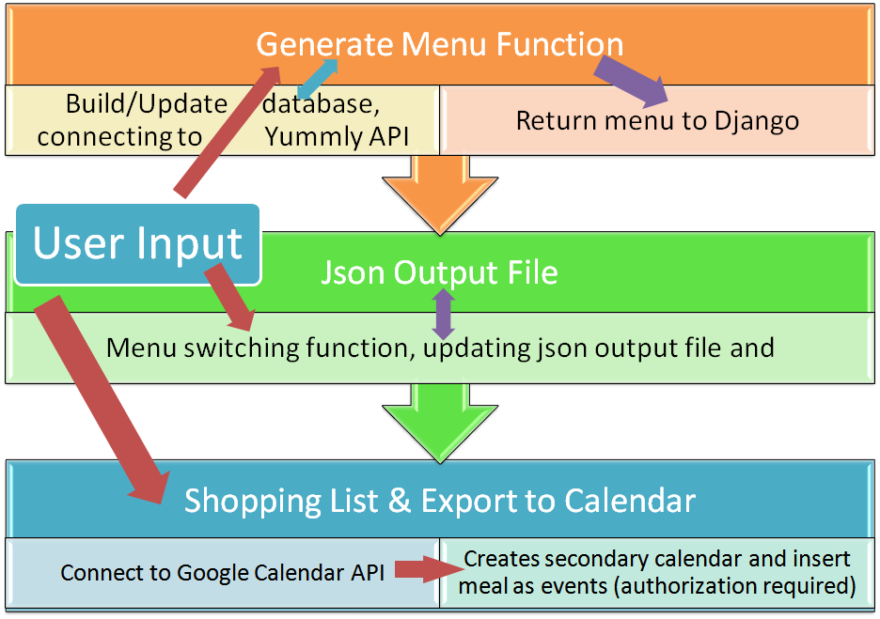
Notes:
Lisa

Slide 9
User Input
Django form
Dictionary /List
Call own functions
Post results on Django webpage
Notes:
Lisa

Slide 10
1. Generate Menu
Send request to Yummly API for list of receipes
Send request to Yummly API for information about individual receipe
Update database
Generate menu using algorithm
Output in a Json file
Notes:
Lisa

Slide 11
2. User Improves Menu
Django form
Update Json file
Reflect new changes in menu on website
Notes:
Lisa

Slide 12
3. Generate Shopping List
Django form
Information from Json file
Generate shopping list on separate webpage
Notes:
Lisa

Slide 13
4. Export to Calendar
Django form user inputs
Connect to Google Calendar API
Creates secondary calendar (requires authorization)
Insert meal as events (required authorization)
Notes:
Lisa

Slide 14
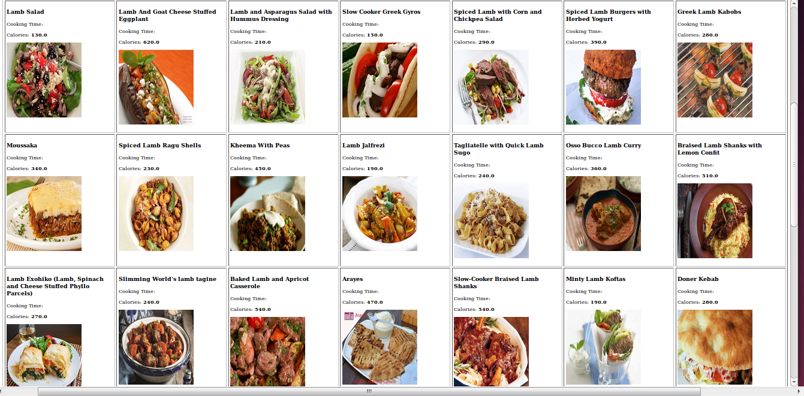
Notes:
notes

Slide 15
Challenges We Met
Data quality (calories, cooking time, ingredient lines, etc)
Shopping list consolidation -- string containing fraction numbers
Synchronize to calendar across months (datetime)
“Major ingredients” definition
Python2
Using various APIs
Passing calls to API vs. generating our own database (data storage)
Optimal parameters in algorithm
Notes:
Data quality: the reason why we chose not to generate the estimated price for the shopping list and not to have a timer.
Datetime library: create a class using the start time and then use the method called timedelta to increment by 1
actually synchronize from the end of the year to the next year!

Slide 16
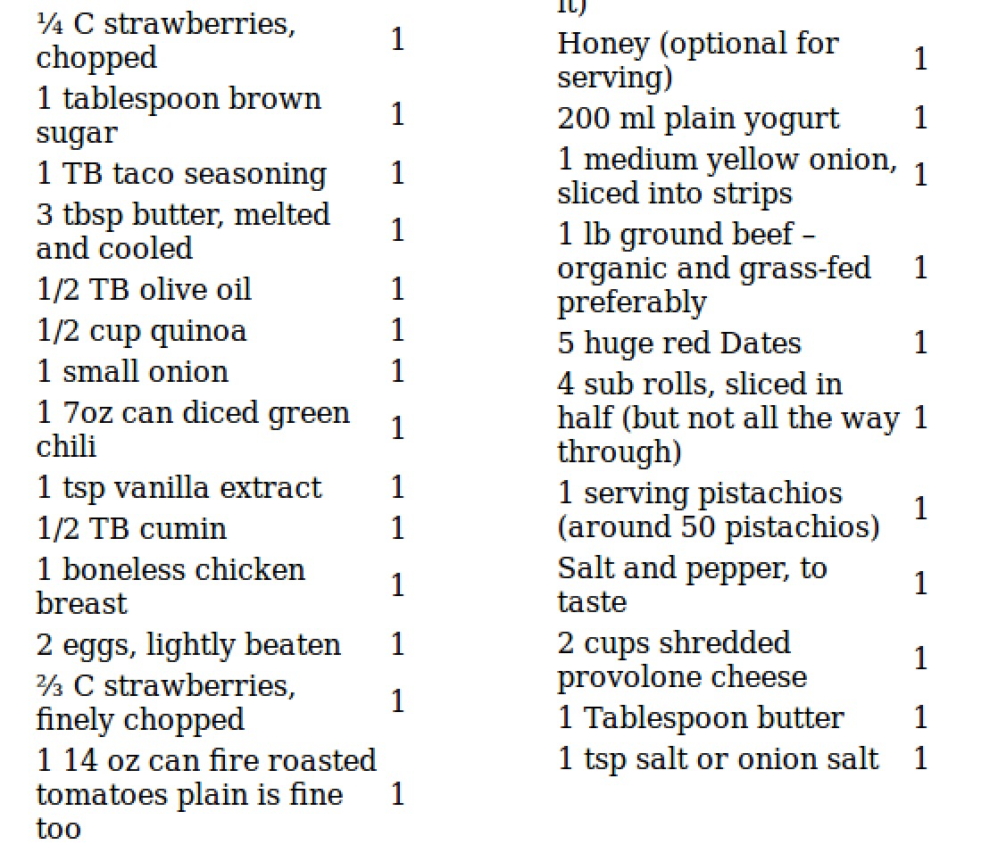
Notes:
Here is a part of a shopping list we generated using random input.
unit different
teaspoon or tsp
number in fraction
not started with a number
price different

Slide 17
Some Parameters in algorithm
MAX_TRIAL_BEFORE_GOING_TO_ALT = 5
MAX_TRIAL_BEFORE_REPEATING_INGREDIENT = 10
MAX_TRIAL_BEFORE_IGNORE_CALORIES = 20
BREAKFAST_CALORIES_WEIGHT = 0.5
LUNCH_CALORIES_WEIGHT = 0.6
DINNER_CALORIES_WEIGHT = 0.6

Slide 18
New Technologies Summary
Python2 Programming Language
Running shell script (to call python2 program) in a Python3 program
Interacting with website using APIs (Yummly, Google Calendar), some with authorizations
  Caching
  Datetime library
Django, html, jquery (toggle)
Notes:
Python2 Programming Language
Caching - Lisa
Running shell script (to call python2 program) in a Python3 program
Interacting with website using APIs (Yummly, Google Calendar), some with authorizations
Datetime library
Django, html, jquery (toggle) - Lisa

Slide 19
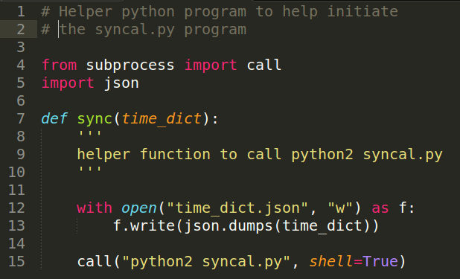
These are interesting…

Slide 20
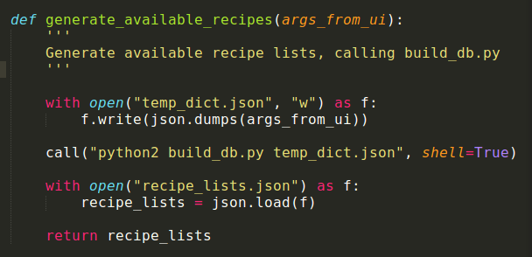

Slide 21
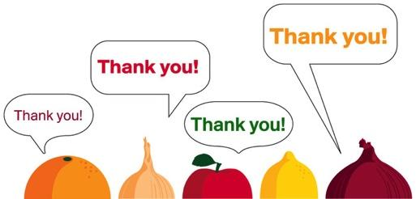
Your Stomach Thanks You!

